Slide 1

Student Registration Management System
2100030823- Raja Rajeswari. M
2100030254- Jenny Meshaiah. K

Slide 2
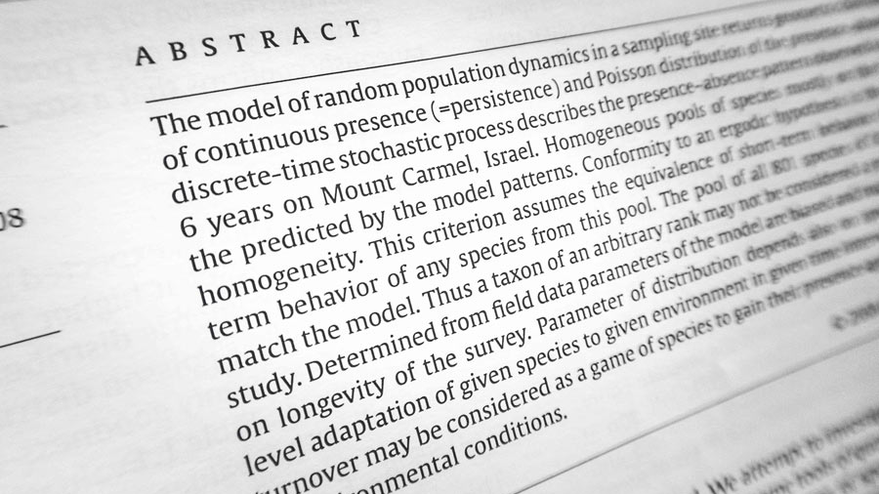
Abstract
With the advent of Information Technology in the last decade, the major focus has shifted from manual systems to computerized systems. Various systems viz. railway reservation, hospital management etc. involving manual work have been automated efficiently. Student course registration process in colleges involve filling registration forms manually, getting it signed by respective subject teachers, and then getting the documents acknowledged from the concerned Advisors, College Deans and Accounts Officers, respectively. Finally, the registration forms are submitted in the Administrative Branch. As is evident, this process is very laborious and time consuming. An Online Student Course Registration System has been developed to simplify the current manual procedure. This system has been developed using Python and tkinter package. Tkinter is mainly used for GUI in pyhton programming

Slide 3

Introduction
The Student Management System Project in Python is a simple console-based system which is very easy to understand and use.
Talking about the system, it contains basic functions which include Add students, view students, search students and remove the student.

Slide 4

Requirements
Windows Operating System
Ram 8gb
Python 3.8.10
PyCharm community edition
Visual studio Code

Slide 5

At which area it is used
Student Registration management system is a kind of management information system can not only record the information for student registration.It is widely used in universities and schools for some universities it was used as a browser-based application and back-end software like SQL

Slide 6
Origin of the Project
The origin of the proposal is because of being sick of the manual registrations filling forms and all those to get rid of the manual registration process we took this project to make all computerized and we do not require to store data it will save and will not be removed as long as we remove.

Slide 7
METHODS AND MATERIALS
In the program we did not used methods in the program that are classes are not used rather we used the functions like display records,add records, reset fields, delete record, edit record, display selected record. We used packages for the project are datetime, tkinter, tkinter. meeseagebox, sqllite3. We created the GUI using tkinter and for storage purpose we used the sqllite3 for storing the data. I chose those functions because the data base should be able add data delete the data and display the data so we created a different functions each and every functionality.
The materials used to prepare the code and execute are the
1. PyCharm
2. Visual studio code
At first the code surfed in the google and we took a sample to make our code we first prepared it in the PyCharm and then after made changes and edits in the visual studio code because it more easy to use than the PyCharm.

Slide 8

Existing systems
The existing system of registration requires many documents and application forms to be filled out. Data must be repeatedly entered at each stage of the process and multiple files are made for each student. Documents are verified with multiple copies made for record and the testing process is conducted independently which again compounds the paperwork

Slide 9
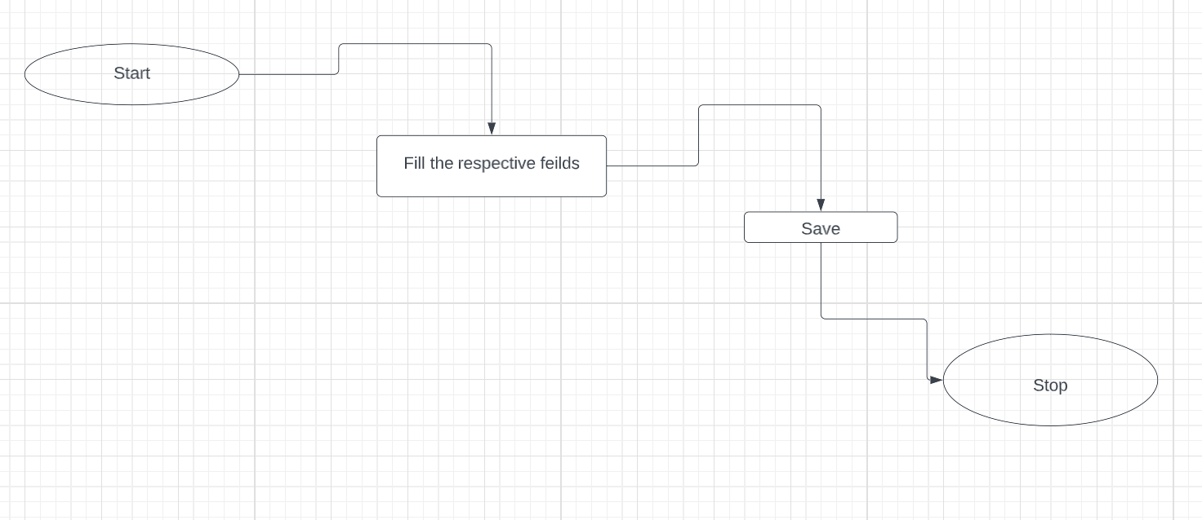
BLOCK DIAGRAM

Slide 10
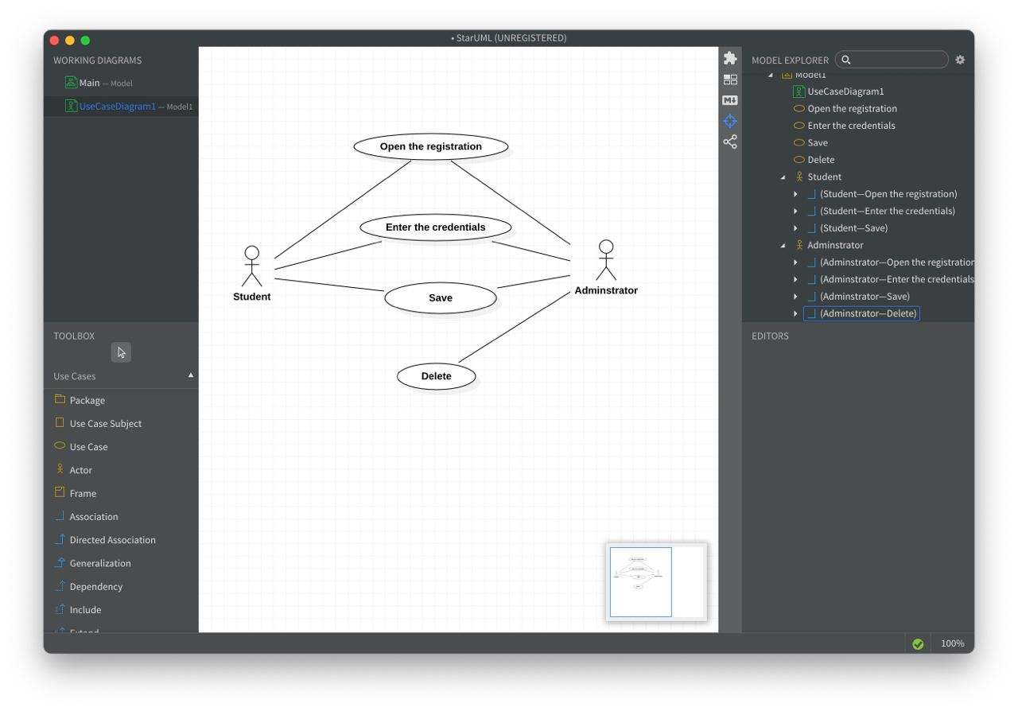
USE CASE DIAGRAM

Slide 11
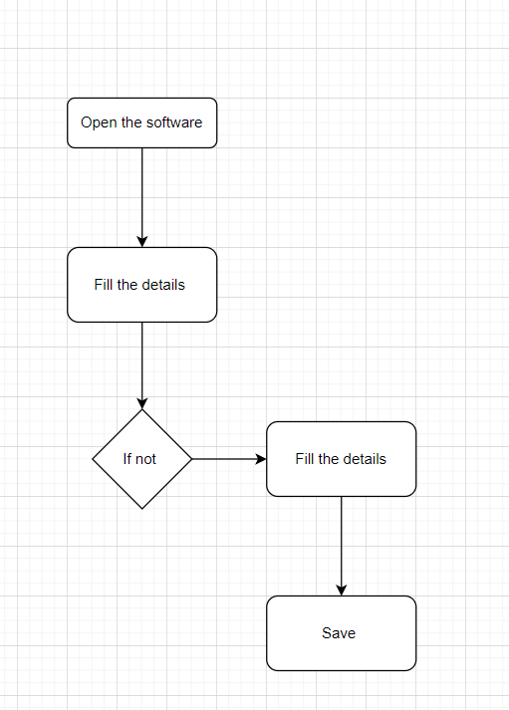
FLOW CHART

Slide 12
LIMITATIONS
At this stage we worked on this project where we need to run the code to open the GUI window or the application in the future days wee need to take it to the we application by using Django or PHP etc.…

Slide 13
References
We surfed the internet for the understanding of the project and we took the faculty help to complete this project
We use GitHub for the help and some websites for the documentation purpose

Slide 14
CODE
https://github.com/jennymeshaiah09/Projects/blob/main/Student%20registration%20system/Code

Slide 15

THANK YOU

